Slide 1
So you want to be a Tie Fighter Pilot!
Training provided by and for Silicon 2021
**** DO NOT SHARE EXTERNAL ****

Slide 2
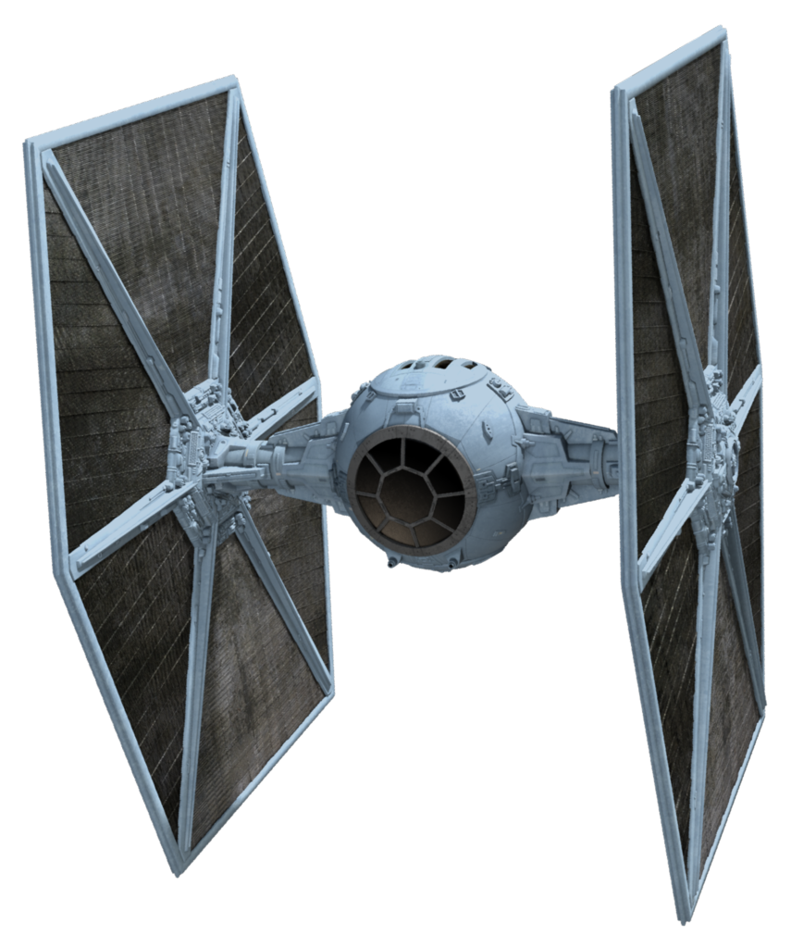
Things you will learn to do
Fly a mark 3 tie fighter!
Use its weapons to fight the rebel scum
Bonus it makes cool noises when it shoots PEW PEW PEW!

Slide 3
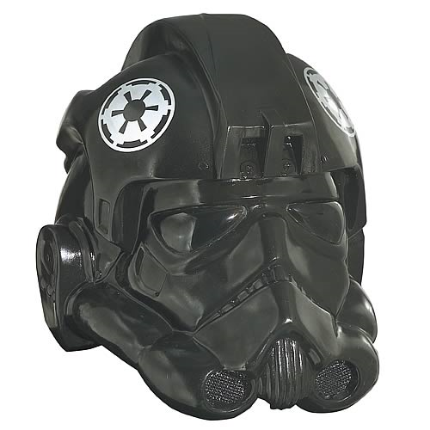
You get to wear this cool hat!
The come in 1 color
They can fog up so just keep that in mind
They can stink so make sure you wash it on a regular basis

Slide 4
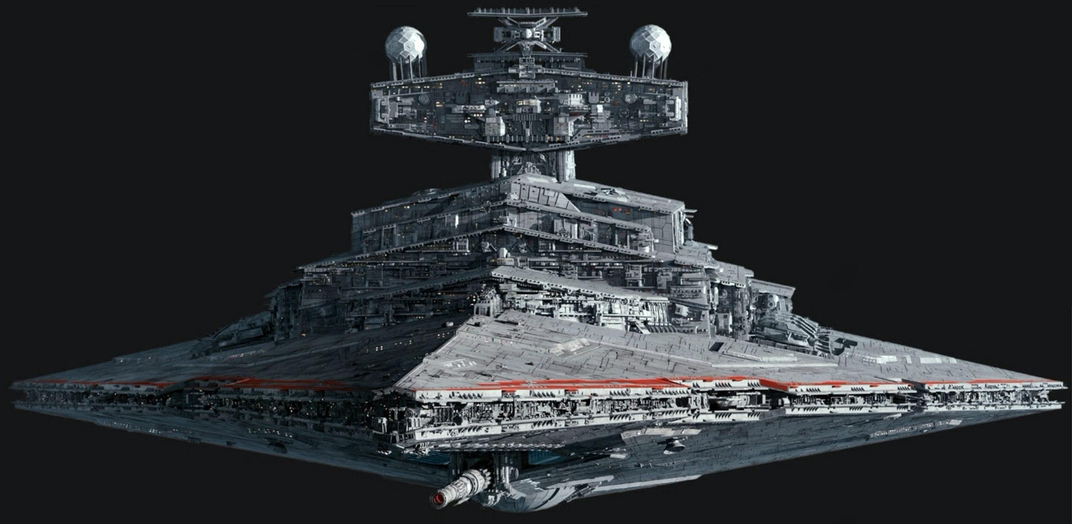
You get to live in a Star destroyer
It is like a giant cruise ship in space but fewer drinks and less sun bathing

Slide 5
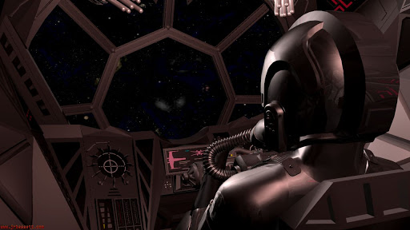
You will need to login each time
Your username will be your TC number
The password will be Silicon{EmpireTieFighter123!!}

Slide 6
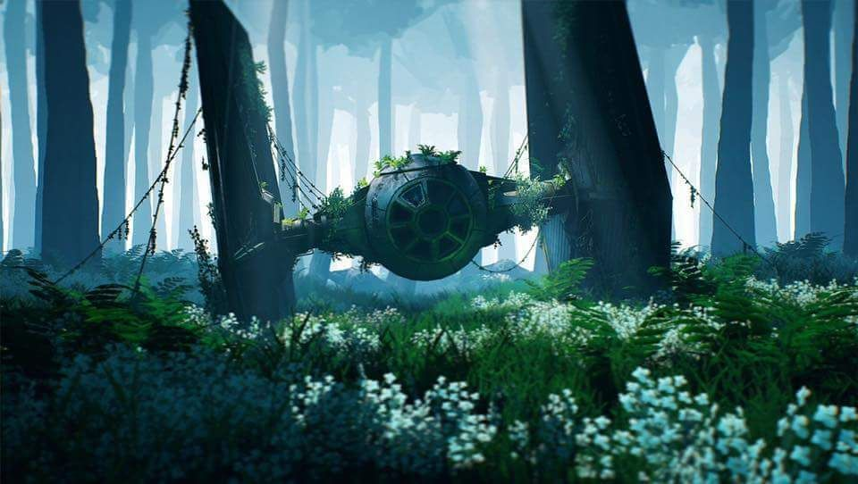
Don’t crash they cost a ton of credits!

Slide 7
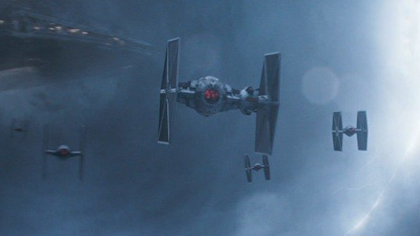
Welcome aboard!
Long live the empire!

